Slide 1
Pulling Repeat Visitors with Onsite
Marketing Techniques
Lecture 6

Slide 2
Deciding Which Onsite Marketing
Techniques to Use
When it comes to choosing those initial, onsite, marketing techniques, consider these factors:
  ✓ What you’re trying to accomplish with your site
  ✓ Your target market
  ✓ How much time you have to maintain the activity
  ✓ How much staff you have for maintenance
  ✓ How much interest you have in the technique

Slide 3
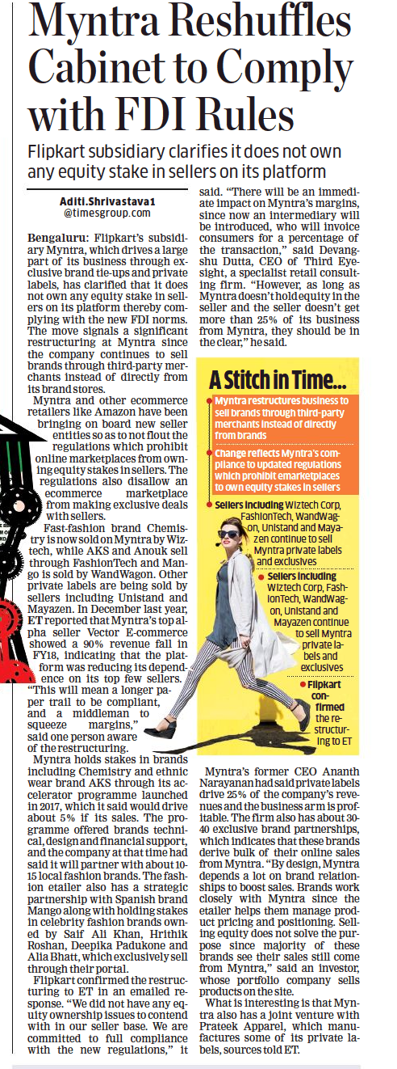
Economic Times 06 Feb 2019

Slide 4
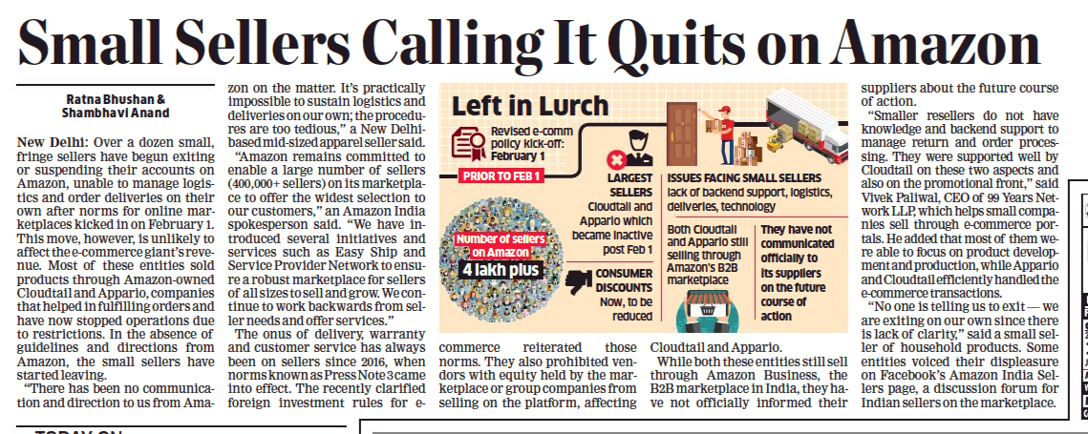
Economic Times 06 Feb 2019

Slide 5
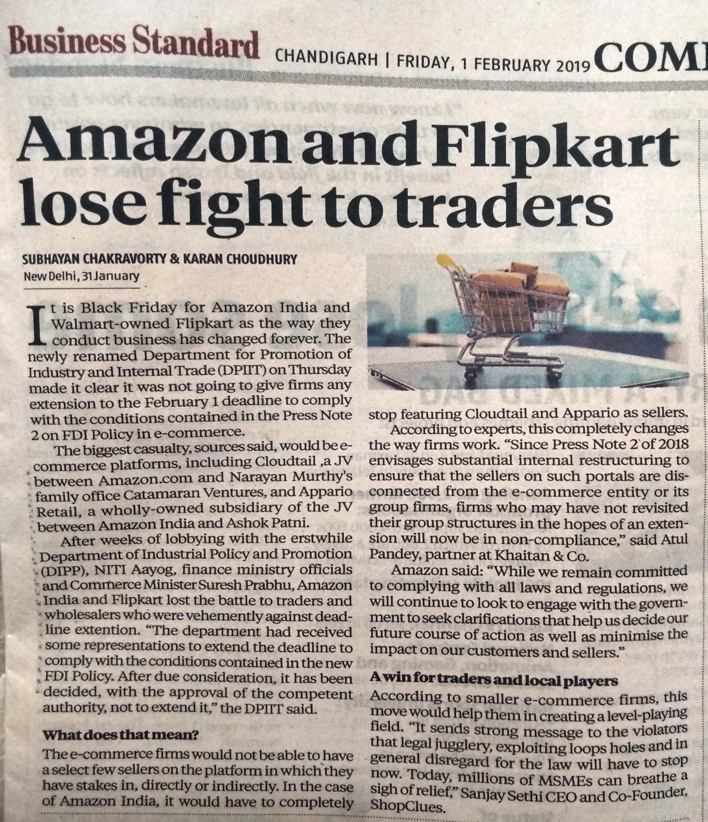
Business Standard, Chandigarh,
01 Feb 2019

Slide 6
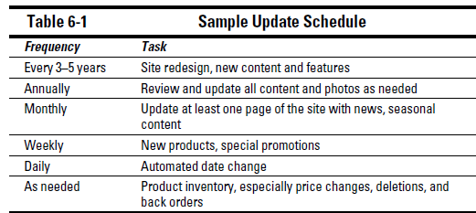
Freshening Your Content
1Establishing an update schedule

Slide 7
Determining what content to update
Your home page might need changes, perhaps because you’ve introduced a new product or want to promote a special offer.
Your About Us page might need to reflect changes in staffing. Perhaps you have updated summer hours, a new location, or new e-mail addresses for Contact Us.
Your product pages might need to be amended with price changes, additions, or deletions.
If you have a media page, you might want to add new press releases, newsletters, or mentions in other media.(Some people create a What’s New page specifically to collect all the changes between site updates)
Using content that updates automatically
(For instance, a stockbroker might want to include a stock ticker or information as the date, weather, or news .)

Slide 8
Building an online community
Interactive Techniques
Supporting an online community on your Web site is one of the most reliableways for you to ensure that visitors return to your site again and again.Online communities may increase traffic, time on site, sales

Slide 9
(a) Blogs (Web logs) are supplanting message boards as the preferred technique for asynchronous discussion. A blog is a form of online journal that allows you to wax eloquently (or tongue-tied) about a subject in your field and solicit suggestions or comments from responsive readers. Unlike messageboards, blogs look like Web pages, complete with links, graphics, sound, and video.(www.blogger.com/start)
  Business marketers have discovered that an onsite blog allows creative opportunities to
    ✓ Attract and retain traffic on a site
    ✓ Obtain positive and negative feedback from customers
    ✓ Generate links to other pages on the Web site
    ✓ Announce new products and test price points
    ✓ Build brand awareness

Slide 10
(b) Wikis are related to blogs, but instead of one primary writer with other people responding, wikis make everyone a writer. They allow multiple users to add, delete, and edit each other’s Web content quickly without much technical knowledge.
Ex-:The Wikipedia free encyclopedia is a prime example of group content that reflects many views.(www.mediawiki.org/wiki/MediaWiki)
(c) Social networking (facebook, Classmates.com)
(d) Message boards — sometimes called bulletin boards, discussion boards, or forums — allow asynchronous communication on your site(ex Dogster.com.)(moderated (someone reviews the posts to filter them for propriety) or unmoderated posting free-for-all).

Slide 11
(e) Guestbook software — a variant of an unmoderated message board — was previously used to register visitors to a Web site and perhaps to gather e-mail addresses.
(Big Nose Bird http://bignosebird.com/carchive/bnbbook.shtml)
(f) Chat room software operates in a similar manner, except that multiple participants can be online simultaneously.

Slide 12
Displaying internal banners
Instead of paid advertising that links to someone else’s site, however, link your internal banners to pages within your own site

Slide 13

What does this ad remind you ?

Slide 14
Collecting testimonials and validations
Offline testimonials reassure prospects about the quality of the product or service you offer.
Testimonials(a testimonial or show consists of a person's written or spoken statement extolling the virtue of a product) can come from an objective press rating, acelebrity, experts in the field, or other customers. Collect testimonials fromsatisfied customers and media mentions at all time

Slide 15
A testimonials section displays a slideshow of testimonials (or any posts of your choosing) in a lovely and simple slide format.
How to create testimonial section –
One of the ways of doing it is organic builder widget plugin .
For example - At wordpress, install the Organic Builder Widgets plugin . Next, follow these steps to add each testimonial as a separate post:
  - Within the customizer, add a new post (Posts > Add New)
  - Add a title (this is where a person’s name would go) and content (the body of the testimonial, or quote) within the content editor.
  - Add a Featured Image for each post/testimonial (optional).
  - Apply a category – existing or Add New Category (ie: “Testimonials”)
  - Apply Organic Custom page template to page you want to use

Slide 16
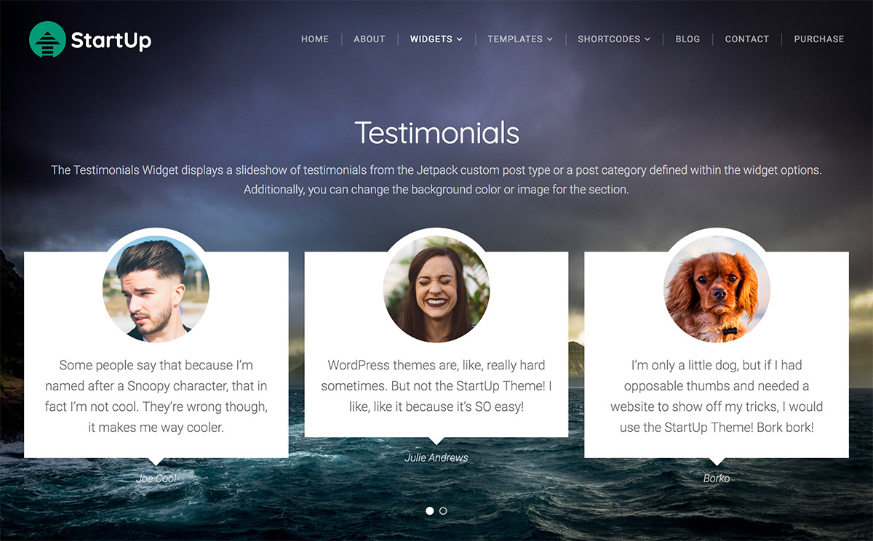

Slide 17
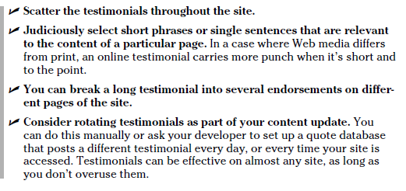

Slide 18
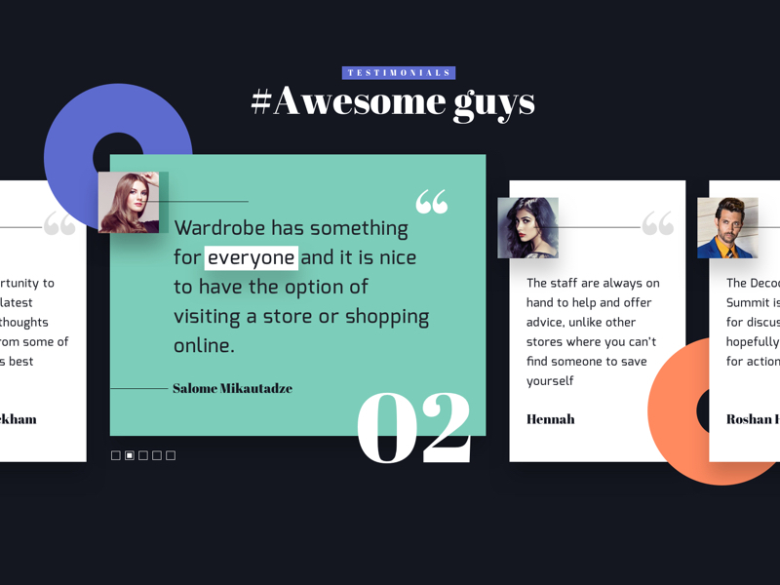
Rotating testimonials

Slide 19
Submitting to award sites
Webby Awards http://webbyawards.com
Web Marketing Association’s WebAward
(www.webaward.org)
Some Web sites gain visitors and credibility by being ranked for their own quality.

Slide 20
Establishing Loyalty Programs Online
Eighty percent of your sales come from 20 percent of your customers.
✓ It costs one-third more to sell an item to a new customer than to sell the same item to an existing one.
Repeat customers spend one-third more than new customers per year.
Rewarding customers and keeping their business (Rewards might be points earned toward a free gift, a discount on future purchases,free shipping, an entry in a drawing, first access to new or exclusive products, or whatever is appropriate for your target market and business.)
Example
  Webloyalty www.webloyalty.com/partnerad.asp Hosts online loyalty programs
  Entertainment Corporate Marketing Solutions www.entertainment.com/cms/programs-loyalty.htm Hosts online loyalty programs

Slide 21
Reference feature on the website
Providing a Tell a Friend option(It’s cost-effective and generally low maintenance unless you’re offering a reward.
Soliciting product reviews Some people prefer the illusion that they make rational purchasing decisions rather than emotional ones. For these buyers, product reviews from a third party offer a perceived, objective rating.
you can include your site for a fee on comparison shopping engines like Bizrate.com to solicit reviews

Slide 22
Doing Viral Marketing
Viral marketing techniques use consumers to promote awareness of your product or site.

Slide 23
